Slide 1


ARM Lab
Creating Standalone ROS Nodes from Simulink

Slide 2
ARM Lab
Requirements:
MATLAB & Simulink
MATLAB Coder
Simulink Coder
ROS Toolbox (Simulink)
Python 2.7
Setting the Python
version in MATLAB
Pipeline:
Setting the model parameters/hardware board settings
Creating a catkin_ws
Creating the Simulink model
rosinit
Building the model as a CPP code
Manually transferring the files to a Linux system (.sh & .tgz)
Creating the package in the catkin_ws
Running the node
Setting the active writable directory

Slide 3
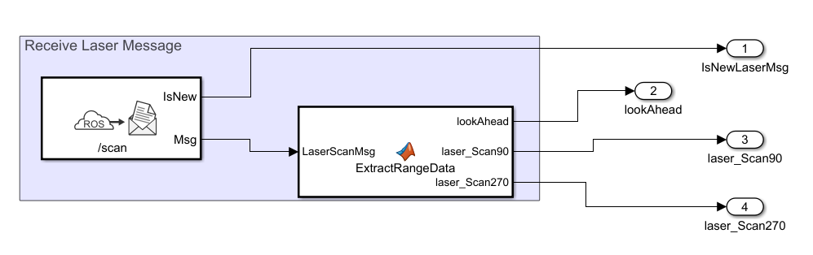
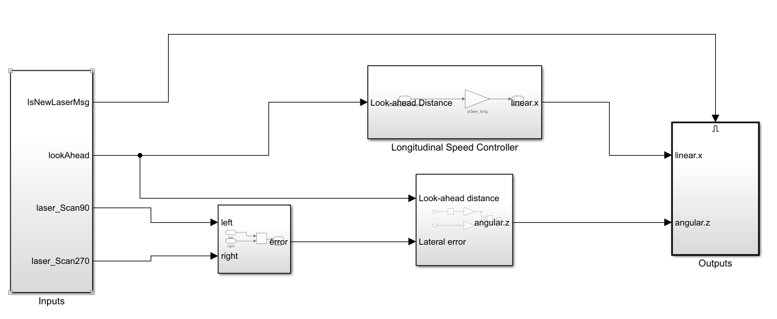
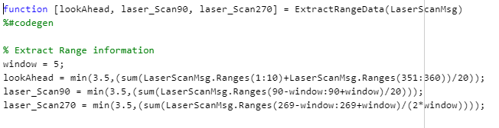
ARM Lab
Should be specified as a bus-bar. Signal size lengths can be changed via the bus-editor present on Modeling > Design tab
Obstacle Avoidance Model from scratch (Simulink Model):
Input

Slide 4
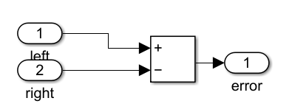
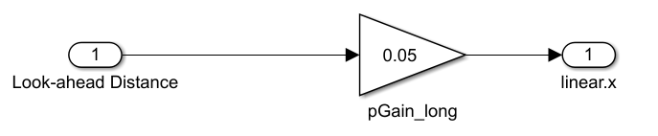
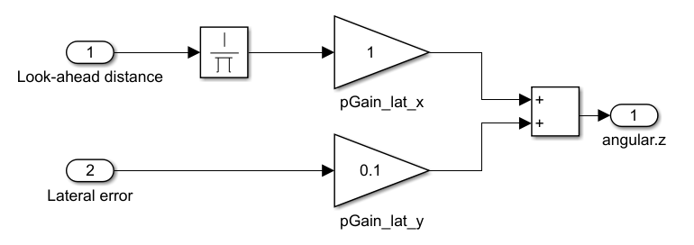
ARM Lab
Obstacle Avoidance Model from scratch (Simulink Model):
Lateral Error
linear.x controller
linear.x controller
angular.z controller
Lateral Error
angular.z controller

Slide 5
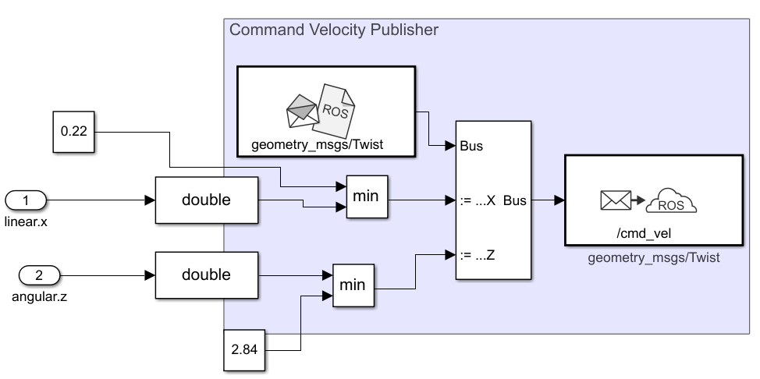
ARM Lab
Obstacle Avoidance Model from scratch (Simulink Model):
Should be specified as a bus-bar. Signal size lengths can be changed via the bus-editor present on Modeling > Design tab
Max velocities on the hardware side
Publisher
Change the datatype because the type upstream is ‘single’, and the publisher values are ‘double’

Slide 6
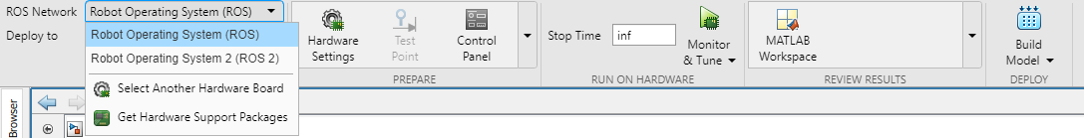
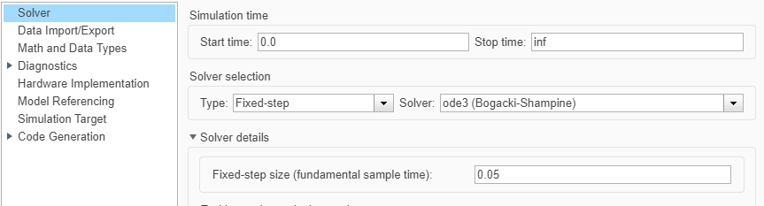
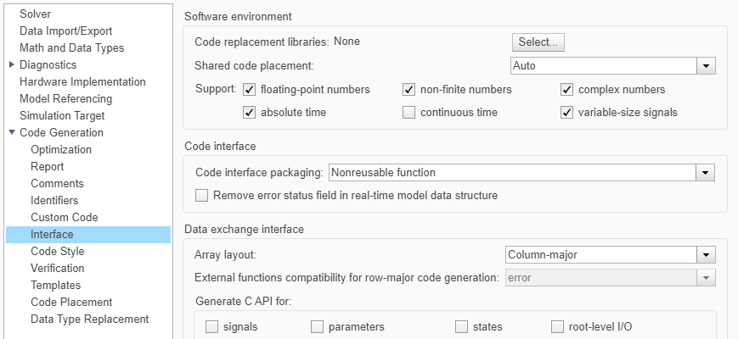
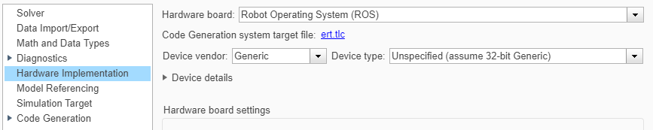
ARM Lab
Model Parameters:
1
2
4
3

Slide 7
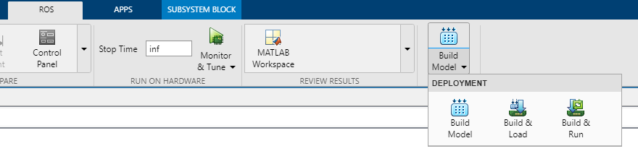
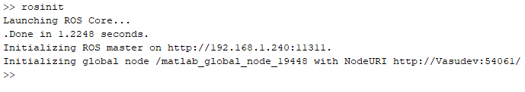
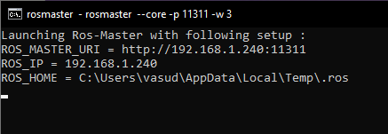
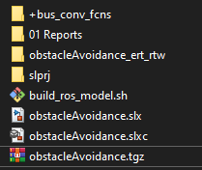
ARM Lab
Building the model as a CPP code:
Set the current path where the generated code files will be stored
Transfer to a Linux system with ROS

Slide 8
ARM Lab
Building catkin package:
With the catkin workspace already created – run the following commands
Copy the .tgz file and the shell command file in the home directory
Make the shell command file an executable (chmod +x <file_name>)
Run the following commands to run the package
cd ~
./build_ros_model.sh obstacleAvoidance.tgz <path to catkin_ws>
Running the node:
Start the ROS master node
Launch the turtlebot3 world in which the node will be run
Source the setup file
Run the following command (while in the workspace) to run the node
rosrun <package_name> <node_name>
To identify the name of the node list down the files in the following directory
/catkin_ws/devel/lib/obstacleavoidance

